Slide 1
New therapies for lipid disorders
CEU 2015
1130 h 24 April 2015
Rob Hegele MD FRCPC FACP
Distinguished Professor of Medicine and Biochemistry
Western University
London, Canada
hegele@robarts.ca
Financial disclosure: speaker and ad board member for
Aegerion, Amgen, Merck, Pfizer, Sanofi, Valeant

Slide 2
Overview
- statins
- current second line drugs
- new drugs

Slide 3
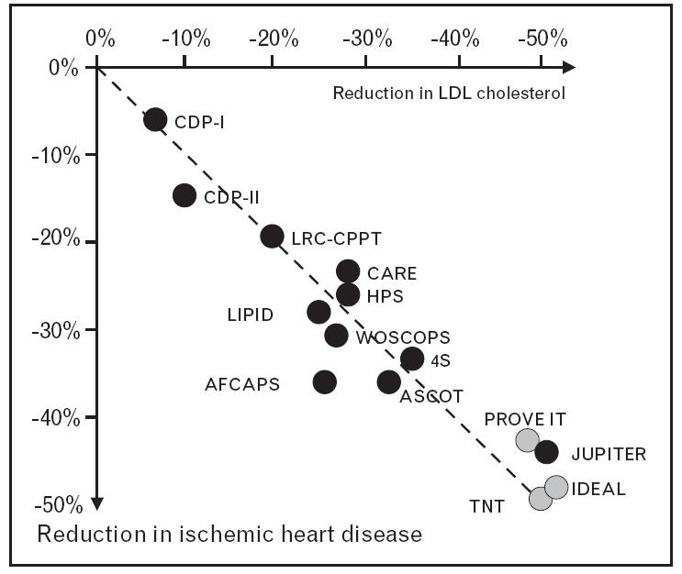
LDL-C and CHD risk

Slide 4
Lower on-Rx LDL-C and reduced risk
Boekholdt SM et al. JACC 2014; 64:5485-94

Slide 5
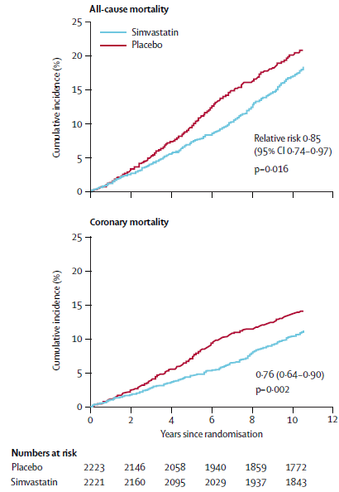
Reduced all-cause mortality with statins
4S Investigators Lancet 2004; 364:771-7.

Slide 6
Purported Adverse Effects of Statins
Good evidence | Unproven/unlikely/idiosyncratic
- muscle-related/myopathy - liver enzyme/transaminitis - diabetes mellitus (related to high-dose statin use and risk factors for DM) | - cognitive impairment - fatigue, headache, dizziness - psychiatric complications - inflammatory myopathies (e.g. polymyositis, dermatomyositis, necrotizing myopathy) - intracranial hemorrhage - cataracts - rheumatoid arthritis - Gl-associated effects - AKI/ renal impairment/failure - erectile dysfunction - gynecomastia - interstitial lung disease - cancer
Mancini GB et al. Can J Cardiol. 2013; 29:1553-1568.

Slide 7
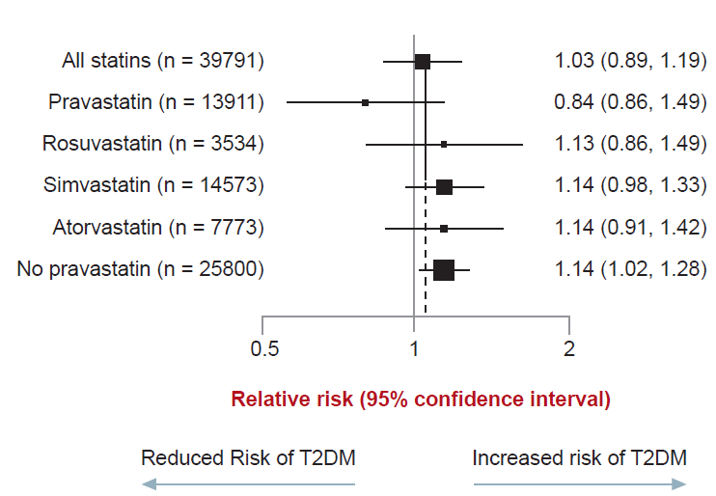
Statins and New Onset T2DM
Effect of statins on T2DM is not
confined to rosuvastatin
However….
“The cardiovascular and mortality benefits of statin therapy exceed the diabetes hazard, including in participants at high risk of developing diabetes”
Adapted from Ridker PM et al. Lancet 2012; 380(9841):565-71; Bell DS and O’Keefe JH, Diabetes, Obes and Metab 2009; 11(12):1114–1121

Slide 8
Second line drugs
Bile acid sequestrants
Ezetimibe
Fibrates
Niacin

Slide 9
Bile acid sequestrants
Lipid Research Clinics Coronary Primary Prevention Trial (LRC-CPPT)
12
Life-table cumulative
incidence of primary end point (definite CHD death and/or definite nonfatal MI) in treatment groups, computed by Kaplan-Meier method.
10
8
Life-Table Cumulative Incidence (%)
Placebo
6
4
Cholestyramine resin
2
0
1
2
3
4
5
6
7
8
9
Lipid Research Clinics. JAMA 1984;251:351-364.
Years of Follow up
Notes:
This Kaplan-Meier table shows the cumulative incidence of the primary end point (definite CHD death and/or definite nonfatal MI) in both treatment groups. Treatment with cholestyramine resulted in a significantly lower incidence of CHD as measured by the primary end point of the study. Benefit, which became apparent 2 years after initial treatment, was widespread throughout the group and participating clinics.
Reference
Lipid Research Clinics. The Lipid Research Clinics Coronary Primary Prevention Trial results: Reduction in incidence of coronary heart disease.
JAMA 1984;251:351-364.

Slide 10
LDL-C and Lipid Changes
1 Yr Mean | LDL-C | TC | TG | HDL | hsCRP
Simva | 1.81 | 3.75 | 1.55 | 1.24 | 3.8 mg/dl
EZ/Simva | 1.38 | 3.25 | 1.36 | 1.26 | 3.3 mg/dl
Δ in mmol/L | -0.43 | -0.50 | -0.19 | +0.2 | -0.5mg/dl
2.5
2.25
2.0
Mean LDL-C (mmol/L)
1.75
median time avg
1.8 vs. 1.4 mmol/L
1.5
1.25
1.0
QE
R
1
4
8
12
16
24
36
48
60
72
84
96
Time since randomization (months)
Number at risk:
AHA Scientific Sessions, 17 Nov 2014

Slide 11
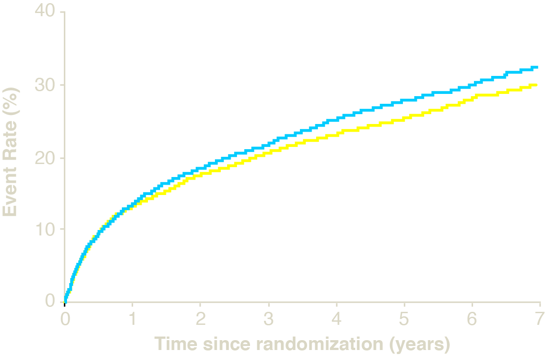
Primary Endpoint — ITT
Cardiovascular death, MI, documented unstable angina requiring rehospitalization, coronary revascularization (≥30 days), or stroke
HR 0.936 CI (0.887, 0.988)
p=0.016
Simva — 34.7%
2742 events
NNT= 50
EZ/Simva — 32.7%
2572 events
7-year event rates
AHA Scientific Sessions, 17 Nov 2014

Slide 12
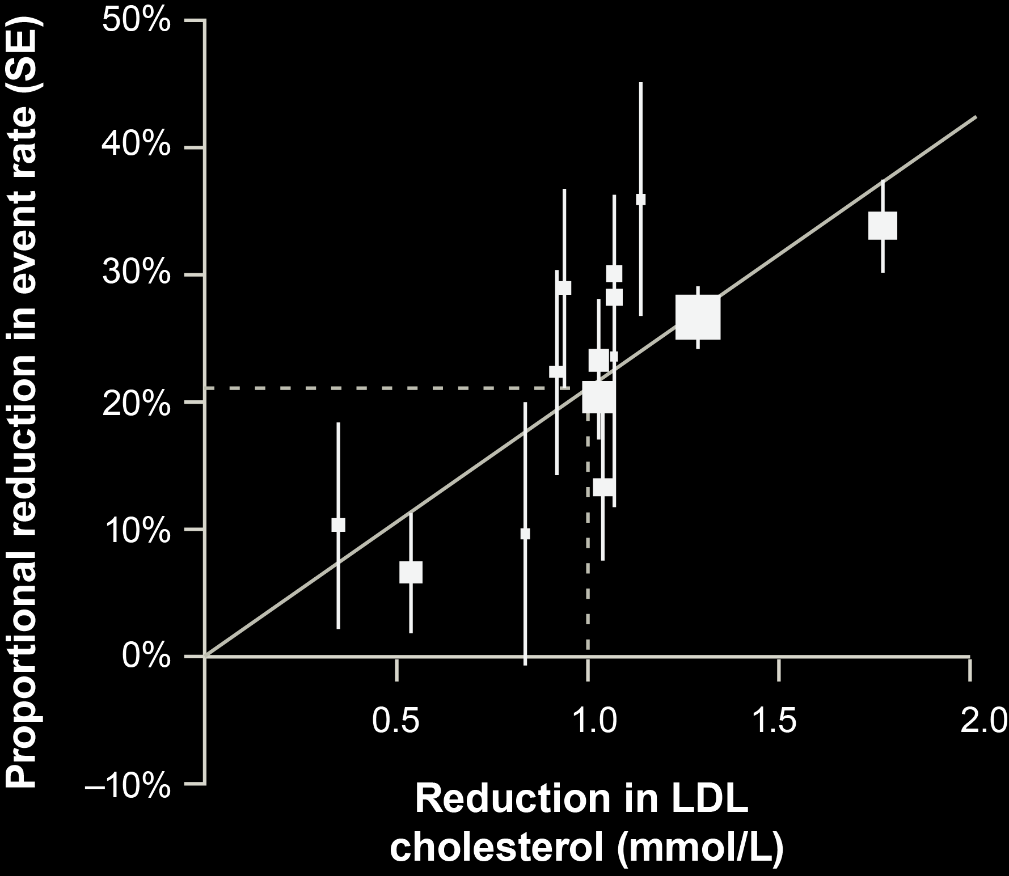
IMPROVE-IT vs. CTT:
Ezetimibe vs. Statin Benefit
IMPROVE-IT
CTT Collaboration.
Lancet 2005; 366:1267-78;
Lancet 2010;376:1670-81.

Slide 13
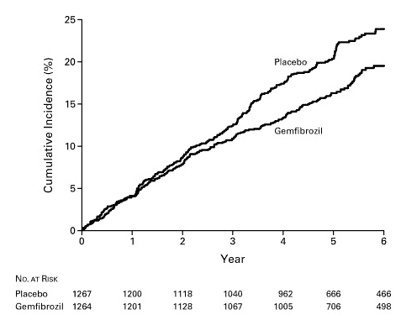
Fibrates: Gemfibrozil Reduced Cardiovascular Events
in Patients with CAD by 22%
Adapted from Rubins HB, Robins SJ, Collins D et al. NEJM 1999;341(6);410-8

Slide 14
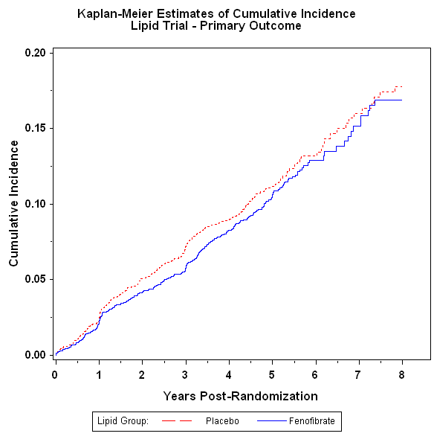
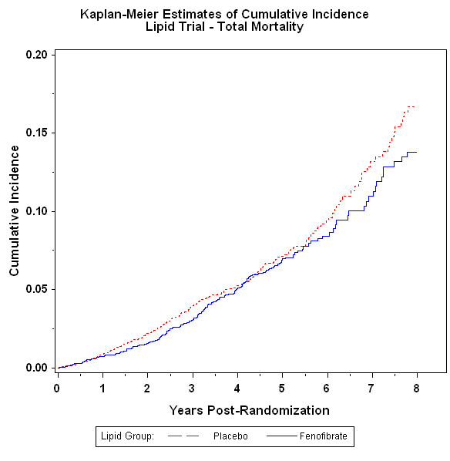
ACCORD-Lipid: MACE

Slide 15
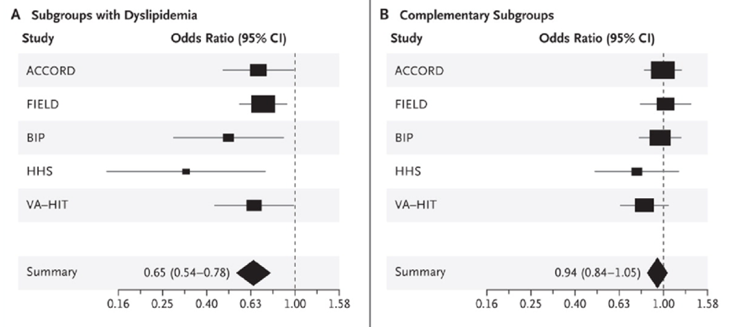
Possible role for fibrates
High TG, low HDL-C subgroups
Normolipidemic subgroups
N Engl J Med 2010; 363:692-695

Slide 16
Coronary Drug Project:
Effect of Niacin in Post-MI Patients
Cumulative Rate of Nonfatal MI in
Post-MI Patients Treated With Niacin or Placebo
15
10
5
Placebo
Recurrent
nonfatal MI
Niacin
Cumulative Event Rate (%)
27%
(P < 0.004)
0 12 34 36 48 60
Months of Follow-up
Patients receiving niacin (n=1119) vs patients receiving placebo (n=2789). Total mortality
was similar between the 2 groups at 5 years.
The Coronary Drug Project Research Group. JAMA. 1975;231:360-381.
Notes:
Coronary Drug Project: Benefit of Niacin in Post-MI Patients
The Coronary Drug Project (CDP) was a placebo-controlled study designed to assess the long-term efficacy and safety of 5 lipid-influencing drugs—niacin, clofibrate, dextrothyroxine, and conjugated equine estrogens at 2 dosage levels––in 8341 men (aged 30 to 64 years) with electrocardiogram-documented previous myocardial infarction (MI).
Initial study conducted between 1966 and 1975 (mean follow-up: 6.2 years)
At end of study, 6008 survivors followed for additional mean 8.8 years.
The significant reduction in event rates produced by niacin therapy are similar
to the results of the statin trials, in both absolute and relative magnitude.
This slide depicts the cumulative event rate of nonfatal MI in the CDP participants.
At 60 months (5 years) the cumulative rate of nonfatal MI was significantly lower in the patients treated with niacin (8.9%) compared with those given placebo (12.2%), a 27% relative reduction; P < 0.004.¹
Total mortality was not significantly different in the two treatment groups at 5 years.
References
The Coronary Drug Project Research Group. Clofibrate and niacin in coronary heart disease. JAMA. 1975;231:360-381.
Canner PL, Berge KG, Wenger NK, et al. Fifteen year mortality in Coronary Drug Project patients: long-term benefit with niacin. J Am Coll Cardiol. 1986;8:1245-1255.

Slide 17
HPS2-THRIVE: Major Vascular Events on Niacin/Laropiprant (ERN/LRPT)
20
15
15.0%
14.5%
Patients suffering events (%)
10
Placebo
ERN/LRPT
5
Risk ratio 0.96
(95% CI 0.90–1.03)
Logrank P=0.29
0
0
1
2
3
4
Years of follow-up
Adapted from Armitage J, et al "HPS2-THRIVE: Randomized placebo-controlled trial of ER Niacin and laropriprant in 25,673 patients with pre-existing cardiovascular disease" ACC 2013.
Notes:
http://www.thrivestudy.org/

Slide 18
CVD end point reduction
Drug class | No background statin | With background statin
Bile acid sequestrants | Yes (LRC-CPPT) | Not done
Ezetimibe | Not done | Yes (SHARP; IMPROVE-IT)
Fibrates | Yes (HHS, VA-HIT) | No (ACCORD, FIELD)
Niacin | Yes (CDP) | No (AIM-HIGH, HPS2)

Slide 19
Combination treatment: safety
Very safe: statin + bile acid sequestrant
statin + ezetimibe
Quite safe: statin + niacin
statin + fenofibrate
statin + bezafibrate
Riskier statins: lova, simva
Reduce dose: fenofibrate if creatinine > 150
Avoid: statin + gemfibrozil

Slide 20
Non-pharmacological LDL-lowering
Compound | Dose | % LDL lowering | Evidence level
Isoflavones (soy protein powder) | 50-100 mg | 3-11% | A-I
Soluble fibre | 5-15 g | 5-20% | A-I
Oatmeal | 60 g | 2-6% | A-I
Plant sterols | 1.3 g | 4-13% | A-I
AHA Step 2 diet |  | 5-10% | A-I
Mediterranean diet |  | 5-10% | A-I
Portfolio diet |  | 10-20% | A-I
Almonds | 50-80 g | 5% | B-I
Green tea extract | 1.2 g | 10% | B-I
High carb diet | 60% of calories | 5-10% | B-I
High protein diet | 25% of calories | 5-10% | B-I
Red yeast rice | 1-2 g | 7-20% | A-IIa
Guggulipid | 100 mg | 12% | A-IIb
Huang et al. Can J Cardiol 2011: 488-505

Slide 21
Looking forward to the 2015 guidelines
keep LDL-C targets
combination Rx
non-statin LDL-C lowering
non-HDL-C as alternate
non-fasting lipids
ongoing RCTs – PCSK9i lower LDL-C < 1.0 mmol/L
ongoing RCTs – CETP inhibitors
Notes:
Due to the importance of cardiovascular disease as a health threat, the need to control cardiovascular risk factors is urgent in patients with diabetes. The rigorous goals for modifiable risk factors, such as for elevated low-density lipoprotein cholesterol (LDL-C) and hypertension, in patients with diabetes often require pharmacological therapy. Similarly, controlling lifestyle risks, such as smoking and physical inactivity, should be pursued aggressively. Such changes should not be just recommended but incorporated into a comprehensive risk management program.
21

Slide 22
Emerging lipid therapies
effect
- lomitapide lowers LDL-C by 50%
mipomersen lowers LDL-C by 50%
anti-PCSK9 lowers LDL-C by 80%
- CETP inh (ana, eva) lowers LDL-C by 40%
- alipogene tiparvovec lowers TG by 30%
anti-APOC3 lowers TG by 50%
anti-ANGPTL lowers TG by 50%

Slide 23
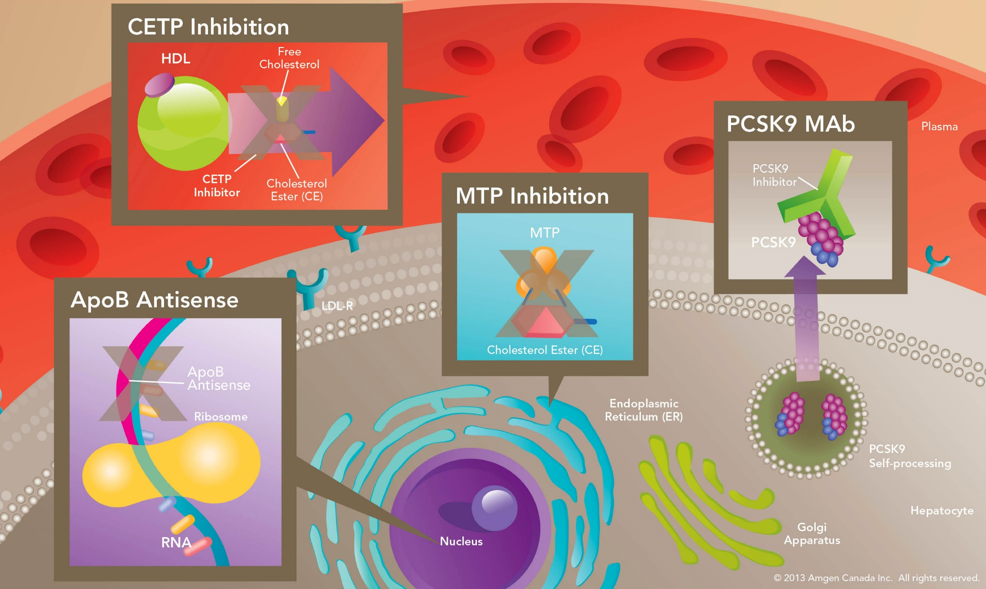
Four Mechanisms for Reducing LDL-C
Lilly SM, Rader DJ. Curr Opin Lipid. 2007;18:650–655.; Shinkai H. Vasc Health Risk Manag. 2012;8:323-331.
Notes:
PCSK9 Mab:
PCSK9 binds to the LDL-C receptor (LDL-R) on the hepatocyte surface and targets it for degradation; resulting in less LDL-R being available to bind LDL-C, consequently increasing plasma LDL-C levels.
Blocking PCSK9 activity inhibits the intracellular degradation of LDL-R, thereby increasing LDL-receptor levels, allowing for more uptake of LDL from the circulation and decreased plasma LDL-C.
ApoB inhibitor:
ApoB forms the backbone, providing key structural integrity, to circulating very-low density lipoproteins (VLDL) and LDL.
Inhibition of ApoB translation leads to the reduction of plasma LDL-C.
MTP inhibitor:
Microsomal Triglyceride Transfer Protein (MTP) mediates the transfer of cholesterol esters and triglycerides to ApoB-containing lipoproteins.
Inhibition of MTP disrupts VLDL assembly and secretion, resulting in reduced circulating LDL-C.
CETP Inhibitor:
Cholesteryl ester transfer protein (CETP) is a plasma protein, bound mainly to HDL, which transfers cholesteryl ester (CE) and triglyceride (TG) between circulating ApoB-containing lipoproteins such as LDL and VLDL.
Inhibition of CETP leads to an increase in plasma HDL-C levels and a decrease in LDL-C.
References:
Lilly SM, Rader DJ. New targets and emerging therapies for reducing LDL cholesterol. Curr Opin Lipid. 2007;18:650–655.
Shinkai H. Cholesteryl ester transfer-protein modulator and inhibitors and their potential for the treatment of cardiovascular diseases. Vasc Health Risk Manag. 2012;8:323-331.

Slide 24
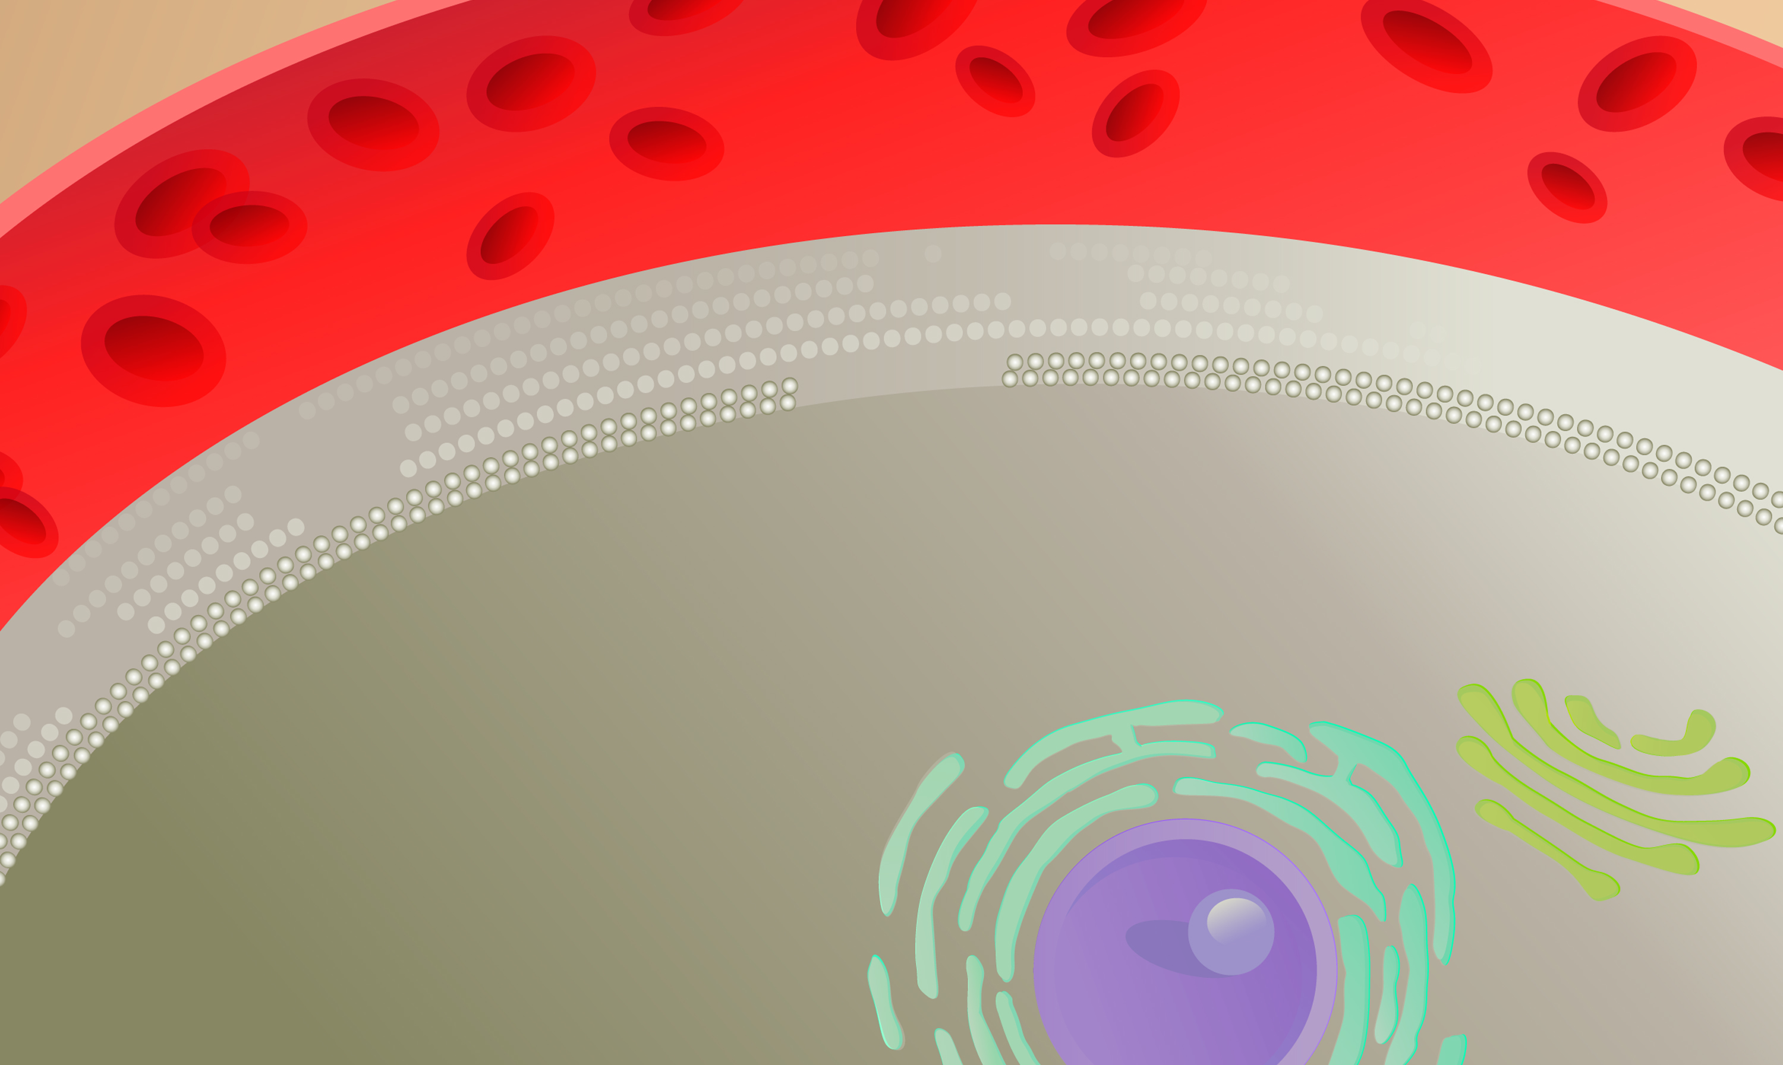
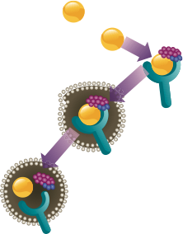
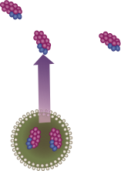





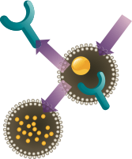



In the Presence of PCSK9, the LDL-R Is Degraded and Does Not Cycle Back to Cell Surface
Serum LDL-Cholesterol Binds to LDL-Receptors. Following Internalization, LDL is Degraded and the Receptor Recycled
Qian YW, et al. J Lipid Res. 2007;48:1488-1498.
Horton JD, et al. J Lipid Res. 2009;50(suppl):S172-S177.
Notes:
Hepatocytic LDL receptors bound to LDL particles are delivered to endosomes, where they disassociate from their LDL particles and are returned to the hepatocyte surface; LDL particles continue to the lysosomes for degradation.
Extracellular PCSK9 binds to the LDL receptor at the cell surface. The LDL receptor/PCSK9 complex is internalized by endocytosis and directed to the lysosomes, where the LDL receptor is degraded instead of being recycled back to the cell surface.
Extracellular PCSK9 effectively reduces the number of LDL receptors present on the hepatocyte surface, which consequently increases plasma LDL-C levels.
References:
Qian YW, et al. Secreted PCSK9 downregulates low density lipoprotein receptor through receptor-mediated endocytosis. J Lipid Res. 2007;48:1488-1498.
Horton JD, et al. PCSK9: a convertase that coordinates LDL catabolism. J Lipid Res. 2009;50(suppl):S172-S177.

Slide 25
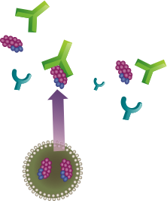

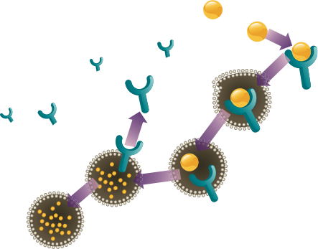



Monoclonal Antibody binds to PCSK9 and inhibits Binding to the LDL-Receptor
Blocking PCSK9 Activity Inhibits
Intracellular Degradation of LDL-R
Qian YW, et al. J Lipid Res. 2007;48:1488-1498.
Horton JD, et al. J Lipid Res. 2009;50(suppl):S172-S177.
Notes:
Inhibition of PCSK9, e.g. by an antibody, reduced the degradation of LDL receptors, thereby increasing LDL-receptor levels, which allowed for more uptake of LDL from the circulation and decreased plasma LDL-C.
References:
1. Qian YW, et al. Secreted PCSK9 downregulates low density lipoprotein receptor through receptor-mediated endocytosis. J Lipid Res. 2007;48:1488-1498.
2. Horton JD, et al. PCSK9: a convertase that coordinates LDL catabolism. J Lipid Res. 2009;50(suppl):S172-S177.

Slide 26
PCSK9-Directed Therapies in Development
Company | Drug | Agent | Indication | Phase
Inhibition of PCSK9 binding to LDLR
Amgen | Evolocumab | Fully Human mAb | Hypercholesterolemia | 3
Sanofi/Regeneron | Alirocumab | Fully Human mAb | Hypercholesterolemia | 3
Pfizer/Rinat Neuroscience | Bococizumab | mAb | Hypercholesterolemia | 3
Novartis | LGT209 | mAb | Hypercholesterolemia | 2
Roche/ Genentech | RG7652 | mAb | Hypercholesterolemia | 2
Eli-Lilly | LY3015014 | mAb | Hypercholesterolemia | 2
PCSK9 protein binding fragment
BMS/ Adnexus | BMS-962476 | Adnexins | Hypercholesterolemia | 1
Inhibition of PCSK9 synthesis (gene silencing)
Alnylam | ALN-PCS02 | siRNA oligonucleotides | Hypercholesterolemia | 2
Idera | TBD | Antisense oligonucleotide | Hypercholesterolemia | Preclinical
Inhibition of PCSK9 autocatalytic processing
Seometrix | SX-PCK9 | Small peptide mimetic | Hypercholesterolemia | Preclinical
Shifa Biomedical | TBD | Small molecule | Metabolic Disorders | Preclinical
Cadila Healthcare | TBD | Small molecule |  | Preclinical
mAb: monoclonal antibody; CVD: cardiovascular disease
Adapted from Rhainds D, et al. Clin Lipidol. 2012;7:621-640.;Lambert G, et al. J Lipid Res. 2012;53:2515-24;clinicaltrials.gov; Stein EA. Swergold GR. Curr Atheroscler Rep. 2013:15:310.
Notes:
References:
Rhainds D, et al. PCSK9 inhibition and LDL cholesterol lowering: the biology of an attractive therapeutic target and critical review of the latest clinical trials. Clin Lipidol. 2012;7:621-640.
Lambert G, et al. The PCSK9 decade. J Lipid Res. 2012;53:2515-24.
Stein EA. Swergold GR. Potential of proprotein convertase subtilisin/kexin type 9 based therapeutics. Curr Atheroscler Rep. 2013:15:310.

Slide 27
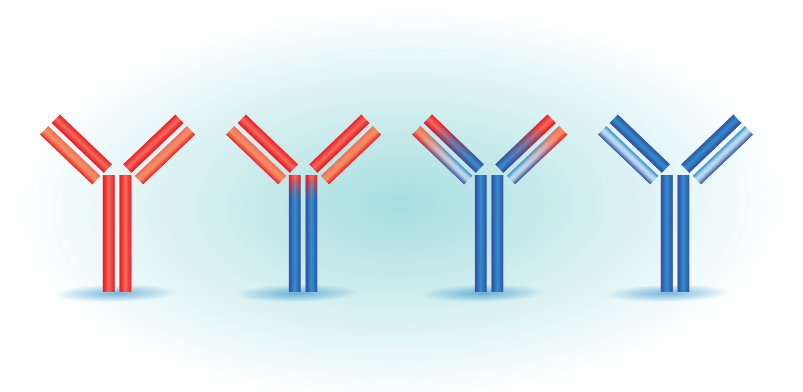
Terminology of Monoclonal Antibodies
Source
(% human protein)
Mouse
(0% human)
Chimeric
(65% human)
Humanized
(> 90% human)
Human
(100% human)
Generic suffix:
-omab
-ximab
-zumab
-umab
High
Potential for immunogenicity
Low
1. Weiner LM. J Immunother. 2006;29:1-9.; 2. Yang XD, et al. Crit Rev Oncol Hematol. 2001;38:17-23.;
3. Lonberg N. Nat Biotechnol. 2005;23:1117-1125.; 4. Gerber DE. Am Fam Physician. 2008;77:311-319.
Notes:
PCSK9 inhibitors (AMG 145/evolocumab, SAR236553/REGN72) are human antibodies.

Slide 28
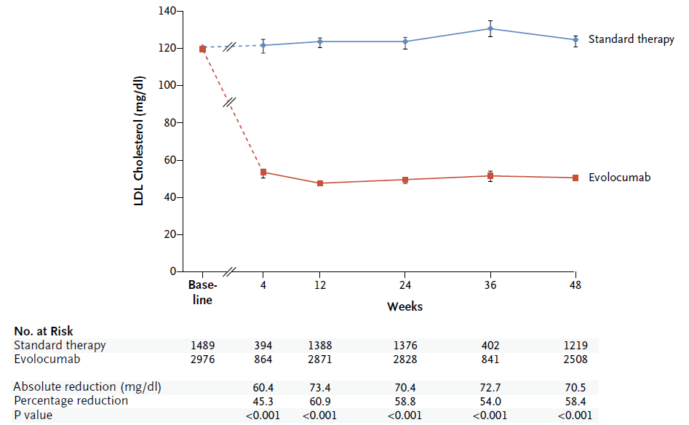
Evolocumab: effect on LDL-C
LDL-C 3.1 mmol/L
LDL-C 1.24 mmol/L
Sabatine M et al. NEJM Mar 2015 online

Slide 29
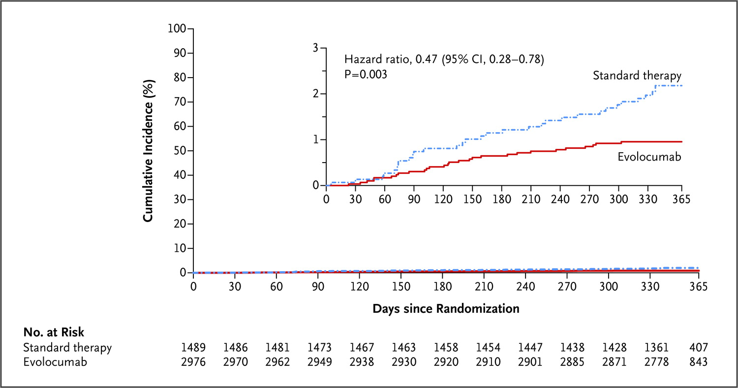
Evolocumab: CVD reduction
Sabatine M et al. NEJM Mar 2015 online

Slide 30
Evolocumab: adverse events
Sabatine M et al. NEJM Mar 2015 online

Slide 31
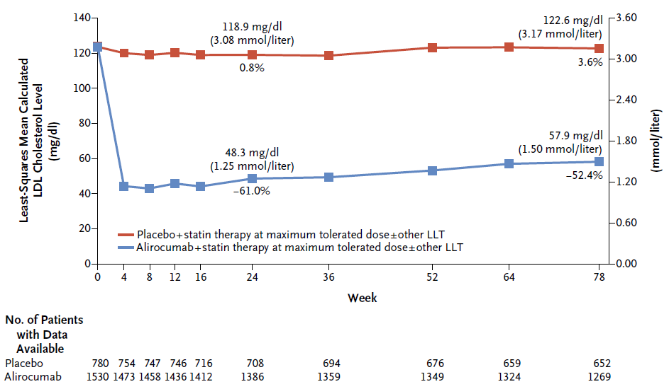
Alirocumab: effect on LDL-C
Robinson J et al. NEJM Mar 2015 online

Slide 32
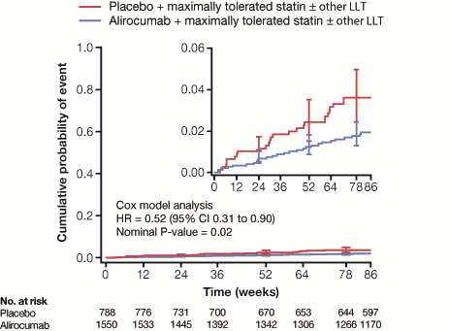
Alirocumab: CVD reduction
Robinson J et al. NEJM Mar 2015 online

Slide 33
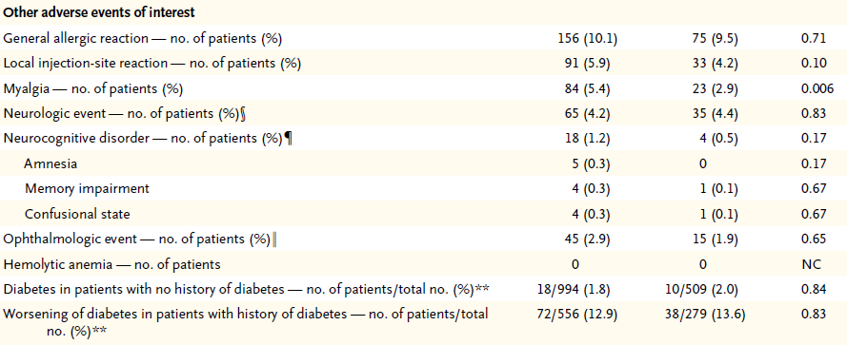
Alirocumab: adverse events
Robinson J et al. NEJM Mar 2015 online

Slide 34
Four Mechanisms for Reducing LDL-C
Lilly SM, Rader DJ. Curr Opin Lipid. 2007;18:650–655.; Shinkai H. Vasc Health Risk Manag. 2012;8:323-331.
Notes:
PCSK9 Mab:
PCSK9 binds to the LDL-C receptor (LDL-R) on the hepatocyte surface and targets it for degradation; resulting in less LDL-R being available to bind LDL-C, consequently increasing plasma LDL-C levels.
Blocking PCSK9 activity inhibits the intracellular degradation of LDL-R, thereby increasing LDL-receptor levels, allowing for more uptake of LDL from the circulation and decreased plasma LDL-C.
ApoB inhibitor:
ApoB forms the backbone, providing key structural integrity, to circulating very-low density lipoproteins (VLDL) and LDL.
Inhibition of ApoB translation leads to the reduction of plasma LDL-C.
MTP inhibitor:
Microsomal Triglyceride Transfer Protein (MTP) mediates the transfer of cholesterol esters and triglycerides to ApoB-containing lipoproteins.
Inhibition of MTP disrupts VLDL assembly and secretion, resulting in reduced circulating LDL-C.
CETP Inhibitor:
Cholesteryl ester transfer protein (CETP) is a plasma protein, bound mainly to HDL, which transfers cholesteryl ester (CE) and triglyceride (TG) between circulating ApoB-containing lipoproteins such as LDL and VLDL.
Inhibition of CETP leads to an increase in plasma HDL-C levels and a decrease in LDL-C.
References:
Lilly SM, Rader DJ. New targets and emerging therapies for reducing LDL cholesterol. Curr Opin Lipid. 2007;18:650–655.
Shinkai H. Cholesteryl ester transfer-protein modulator and inhibitors and their potential for the treatment of cardiovascular diseases. Vasc Health Risk Manag. 2012;8:323-331.

Slide 35
Lomitapide: LDL-C change from baseline
(Week 126 Completers Population)
10
Phase 3
Long-Term Extension
0
–10
–20
–30
Mean % change in LDL-C (±95%CI)
–40
–50
–60
–70
–80
0 10 18 26 36 46 56 66 78 90 102 114 126
Week
n:
17 17 16 17 17 17 17 17 17 17 17 17 17
Notes:
RE Footer, ‘Proprietary…..Reserved’ is revised to ‘Proprietary…..Ltd.’ to match the content in the HCP guide.
Re Body, this slide contains information from a clinical paper.

Slide 36
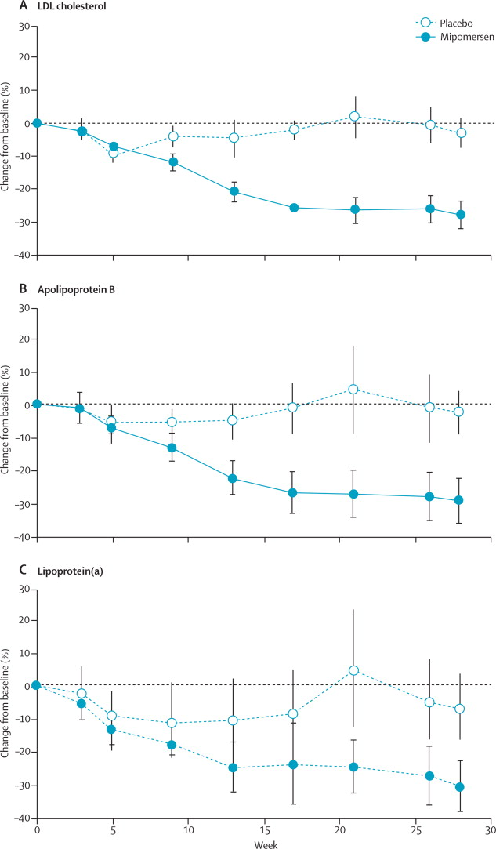
APOB antisense: mipomersen in HoFH
Raal D et al. Lancet 2010; 375:998-1006.
Notes:
Reference:
Stein EA, et al. Apolipoprotein B Synthesis Inhibition with Mipomersen in Heterozygous Familial Hypercholesterolemia: Results of a Randomized, Double-Blind, Placebo Controlled Trial to Assess Efficacy and Safety as Add-on Therapy in Patients with Coronary Artery Disease. Circulation. 2012;126:2283-92.
Visser ME, et al. Mipomersen, an apolipoprotein B synthesis inhibitor, lowers low-density lipoprotein cholesterol in high-risk statin-intolerant patients: a randomized, double-blind, placebo-controlled trial. European Heart J. 2012;33:1142–1149.

Slide 37
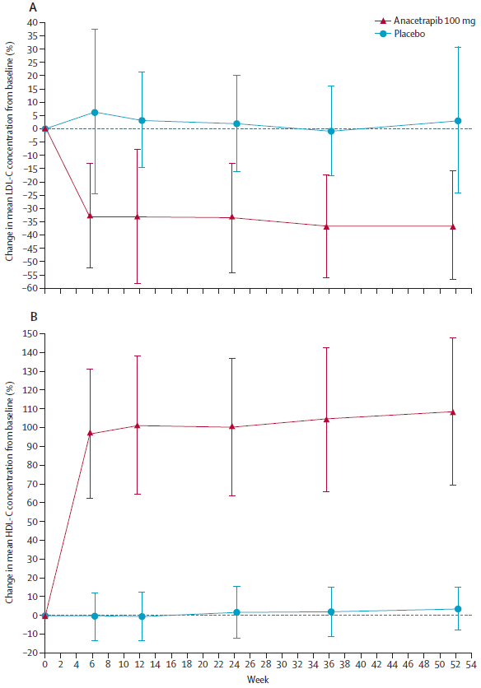
CETP inhibition: effect on LDL-C
Kastelein J et al. Lancet 2015 75:998-1006.

Slide 38
CETP inhibition: effect on HDL-C
Kastelein J et al. Lancet 2015 75:998-1006.

Slide 39
Summary
statins are good
LDL-C targets will remain in guidelines
second line drugs work – depends on context
novel Rx for LDL-C:
    PCSK9 inhibitors
    lomitapide
    APOB antisense
    CETP inhibitors

